Slide 1
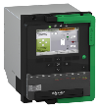

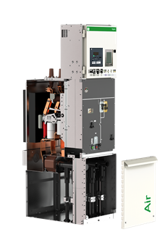




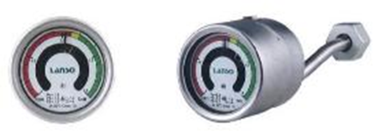



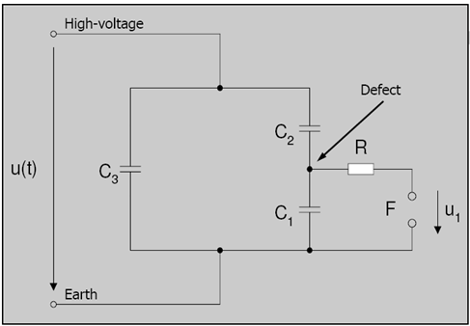


Ready for digital by 2020
IED
1- Protection
2- Metering
3- Condition Monitoring
CB Electrical monitoring
1- Switching time
2- Circuit current of Motor
3- Voltage of Motor
4- Times of Motor
CL110
SD20
CB Characteristic
Gas Monitoring
1 Gas density monitoring
2 Gas temperature monitoring
3 Gas humidity monitoring
Humidity sensor
RFID
天线
TH110-R
TR Monitoring on cable terminal
1 Temperature rise
monitoring in cable compt.
TR Monitoring on cable side
1 Temperature rise
monitoring in cable compt.
PD Monitoring
Partial discharge monitoring of switchgear
Note:
Zigbee
RFID
TH110

